Slide 1

Development of machine learning models to process Electronic Health Records – Explainable Models
Week 14 Meeting, 31/1/2021

Slide 2
Finally understood why knn imputation takes so long
The knn imputation takes longer as the dataset is larger as it computes a Euclidian matrix of the whole dataset (843312 × 16) (17569 X 768) 843312 x 843312 17569x 17569
Should we be doing imputation only based on the information from each patient?
Since it is medical data, and it should only follow the trend from the same patient? Instead of every patient
The 2 closest neighbour to patient A might be data rows from patient Z and patient O.
For example, patient A has height 182cm and blood pressure 80 but glucose is missing, KNN finds the neighbour patient Z, where it has height 181cm and blood pressure 78, with glucose 110 and second closest neighbor patient Z with glucose 150, the imputed value will be 130 if n_neighbors=2.

Slide 3
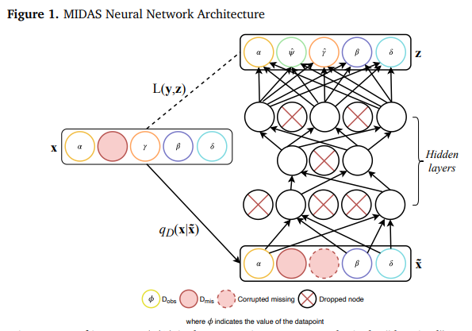
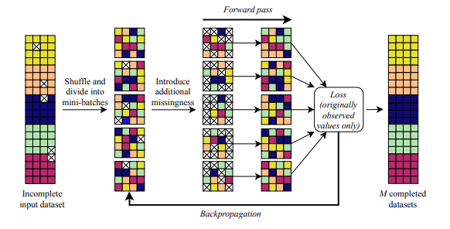
Multiple imputation with deep learning (MIDA)

Slide 4
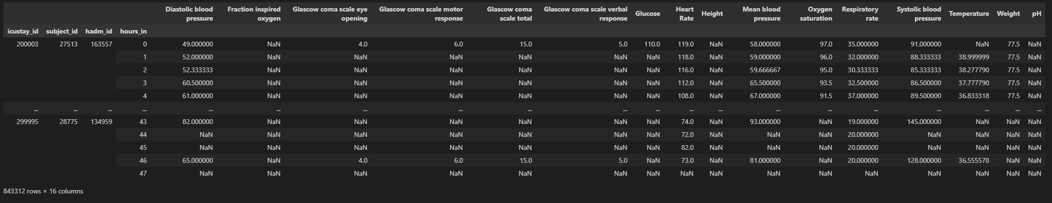
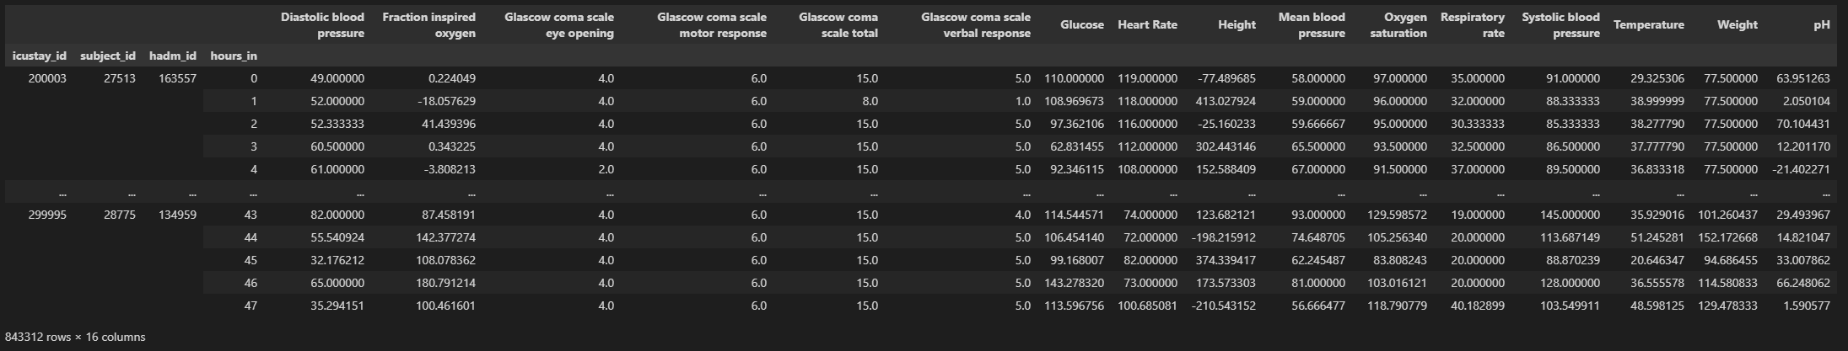

Slide 5
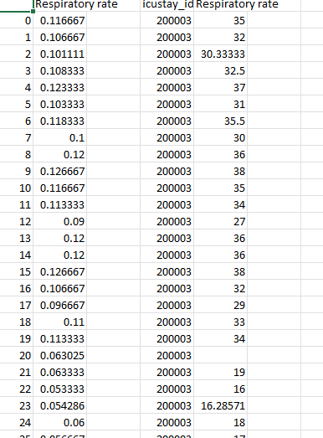
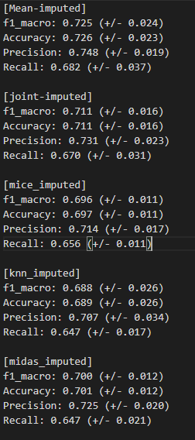
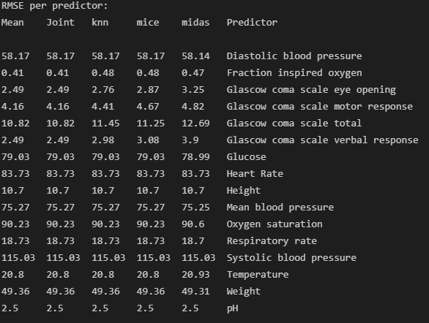
Results comparison

Slide 6
Plan for upcoming weeks
Jan 31- Feb 7: Create comparison metrics pipeline + Optimize models (make changes) + feature selection
Feb 7 – Feb 14: Look at extraction Pipeline + masked data prediction
Finish introduction and background
Feb 14 – Feb 21: Add imputation methods if all models are optimized + Deep learning classification
Finish Analysis/ requirements
Feb 21 – Feb 28: Design, Implementation
Feb 28 – Mar 7: Evaluation, Conclusion
Mar 7 - Mar 14: Complete First Draft 2 weeks before deadline

Slide 7
New title?
A comparison of imputation strategies on electronic health records
A Performance comparison of imputation strategies on electronic health records
Development of imputation strategies to process electronic health records
Imputation methods for Electronic health record
Imputation strategies for Electronic health record

Slide 8
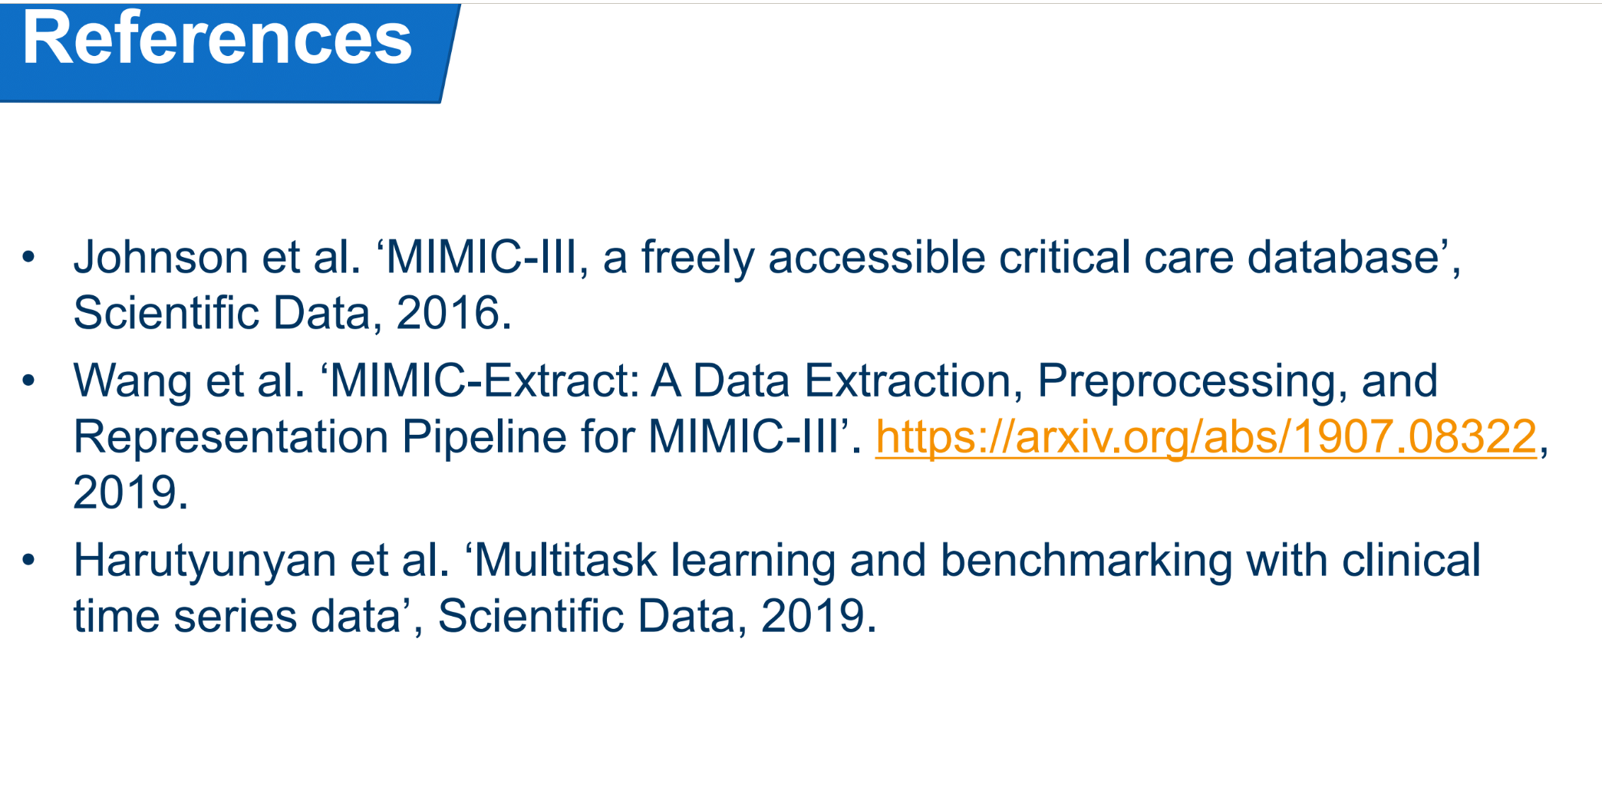
Look at extraction papers
https://arxiv.org/abs/1907.08322
Will fix extraction pipeline when deep learning imputation is done

Slide 9
Imputation Correlation

Slide 10
Imputation distribution with scaling

Slide 11
Dissertation
Missing at random, Not at random explain
Time series dependency not well addressed

